Slide 1




Adding Bioschemas markup to GitHub pages
License: Attribution 4.0 International (CC BY 4.0)
Leyla Jael Castro

Slide 2

Adding Bioschemas markup
We use and recommend markup in JSON-LD 🡪 easy to read by machines and humans
Markup can be added to any web page

Slide 3
What can you expect from this lesson?
Title: Adding Bioschemas markup to GitHub pages
Keywords: Bioschemas, markup, GitHub pages, JSON-LD, Jekyll
Description: In this lesson we will demo how to add Bioschemas markup to GitHub pages using Dataset (vr. Draft 0.4), ComputationalTool (vr. Release 1.0) and TrainingMaterial (vr. Draft 0.9) profiles
Mentions:
This lesson reuses some information from an online Bioschemas tutorial
This lesson uses the repository (data, code and pages) at https://github.com/zbmed-semtec/bioschemas-github-markup-example
Audience: This lesson is intended for anyone interested in Bioschemas markup
Skills required:
How to use and run GitHub pages
Basic understanding of JSON-LD
Basic knowledge about Bioschemas (e.g., what a profile is)
Learning outcomes:
Explaining different approaches to add Bioschemas markup to GitHub pages
Using Bioschemas markup on your own GitHub pages
Describing some of the minimum elements for the Bioschemas profiles Dataset, ComputationalTool and TrainingMaterial

Slide 4
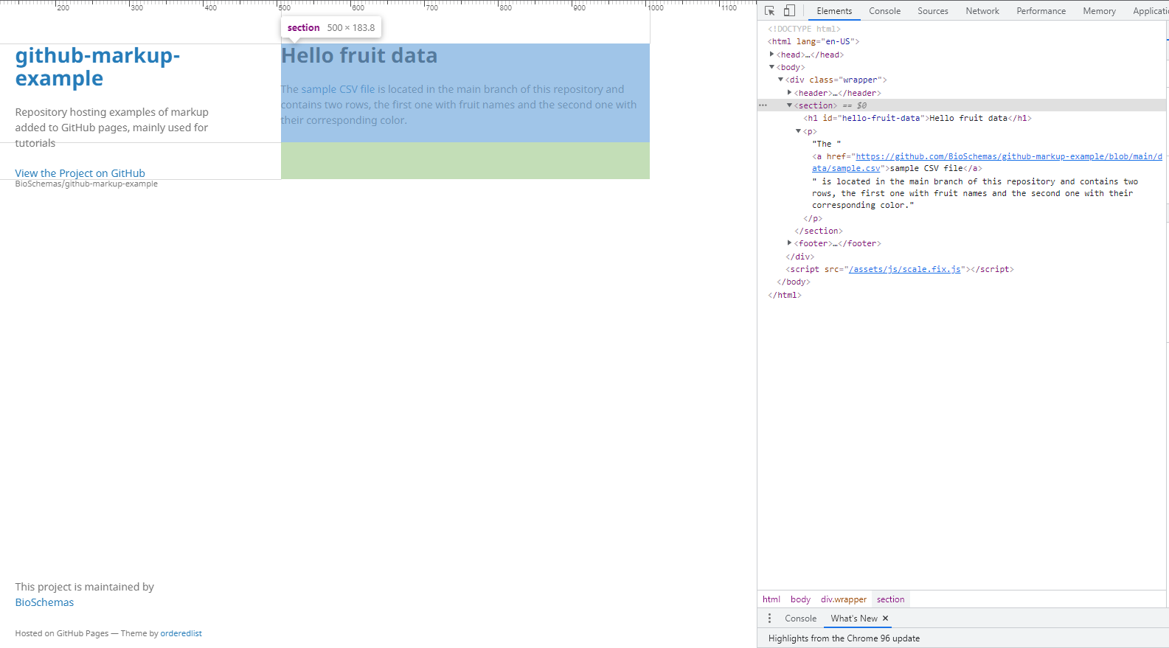
Page without markup

Slide 5

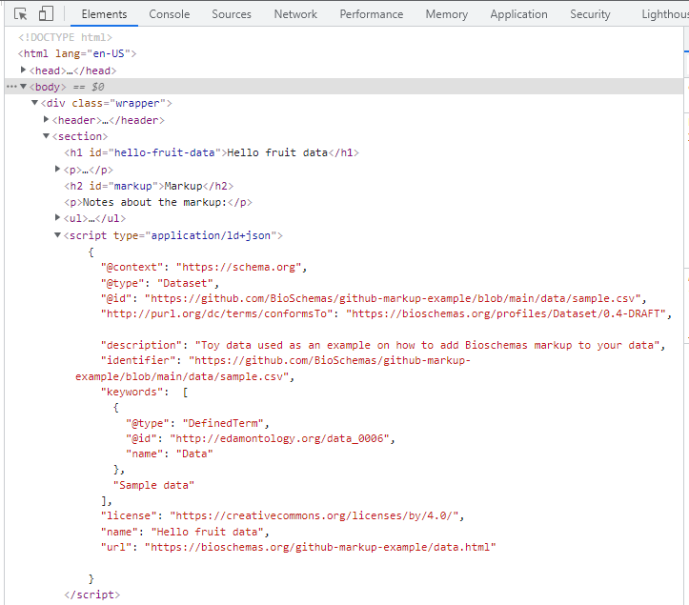
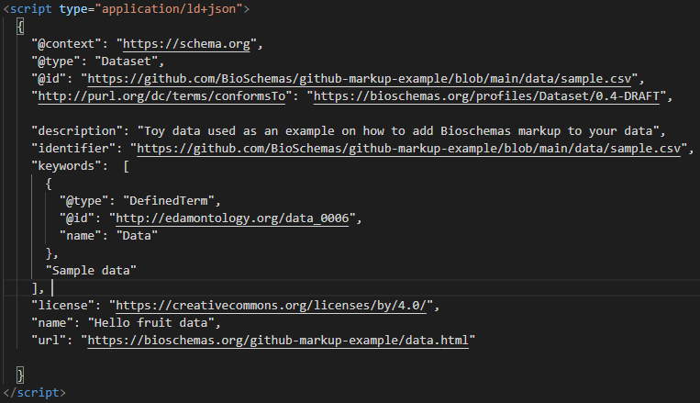
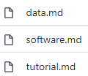

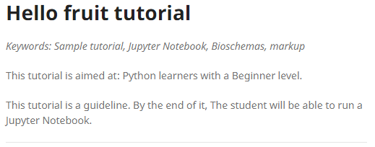
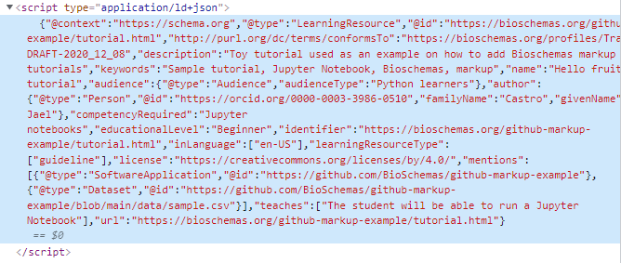
Tasks of the day
No
Clone the repository
Select the branch
Make sure your GitHub pages are running
Running?
Refresh your pages and go to any of the ones with markup
Pay attention to JSON-LD on the bottom of the MDs
Look at
Move to branch
Use the developer tools to see JSON-LD
Now move to branch
Look at
Refresh your pages and go to any the tutorial page
Look at the top, it has some markup data now
Try either way (with/out layout) on your own pages
Look at the markup again

Slide 6
Adding markup directly to the pages

Slide 7
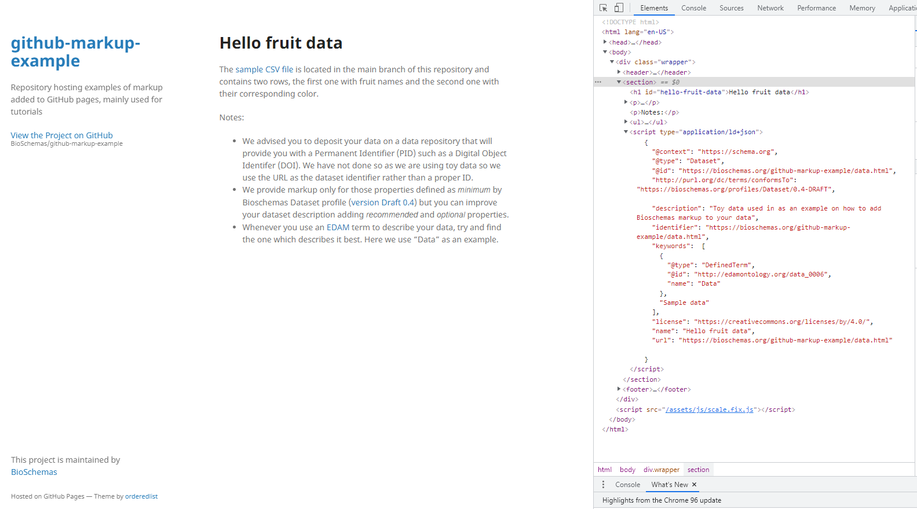
Page with markup

Slide 8
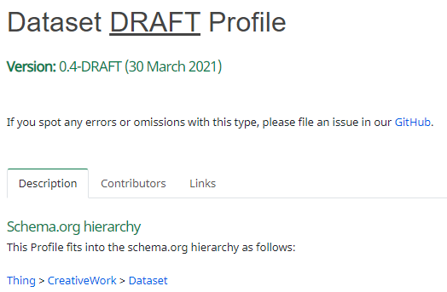
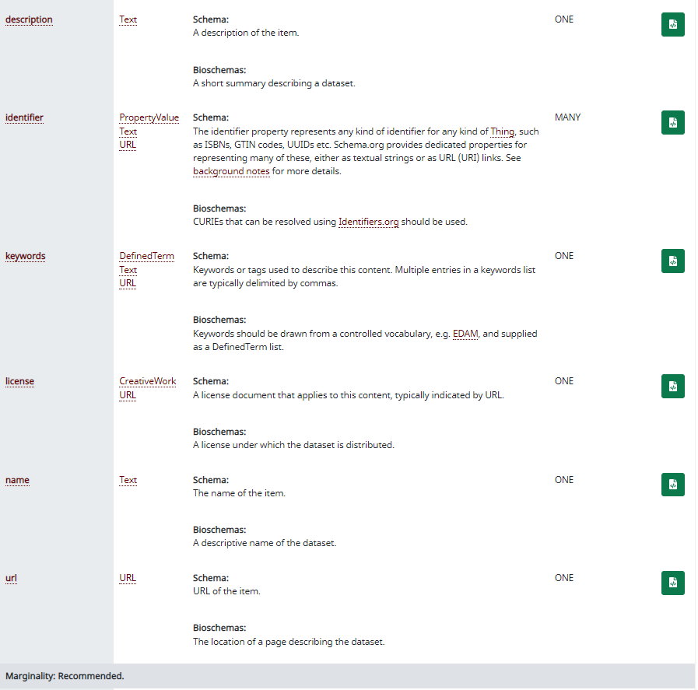
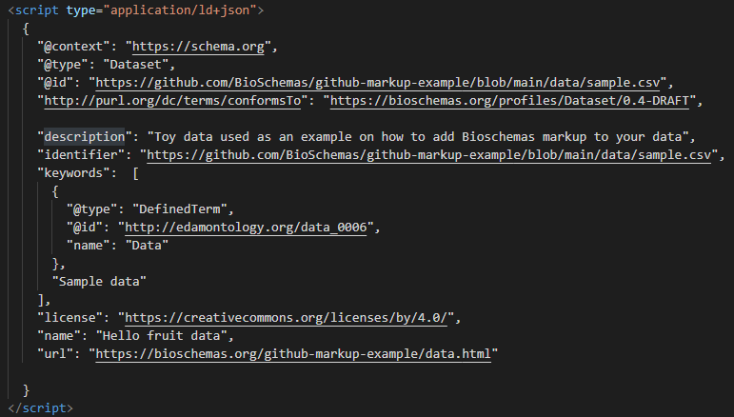

Slide 9
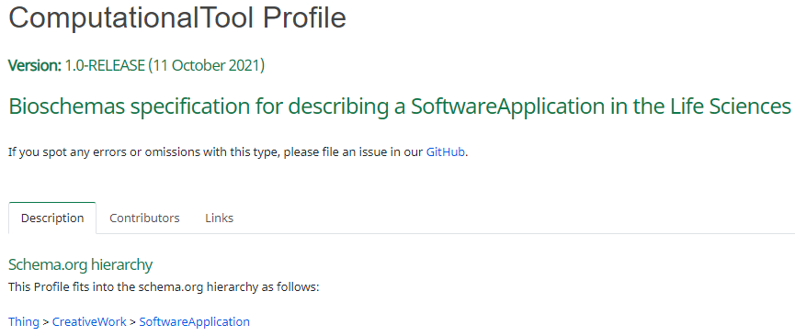
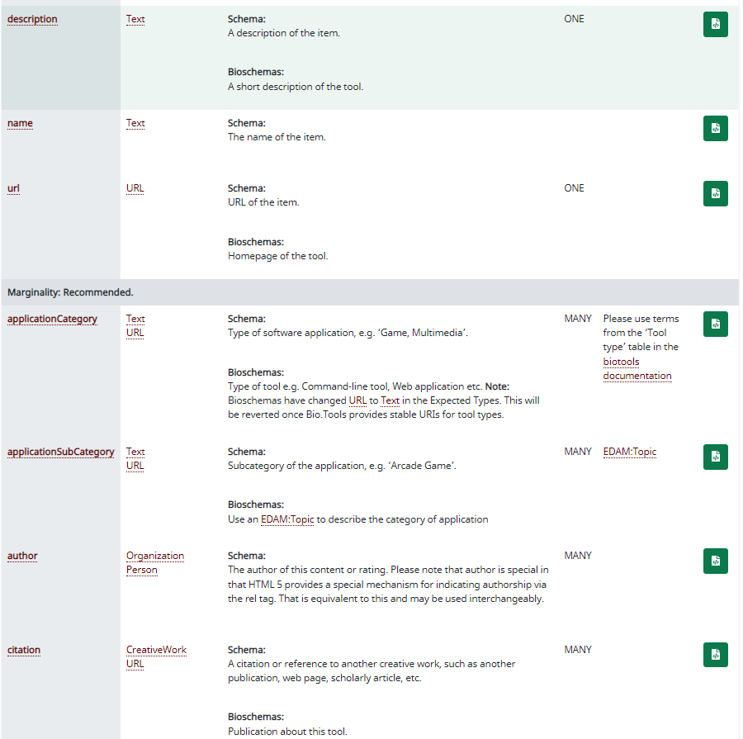
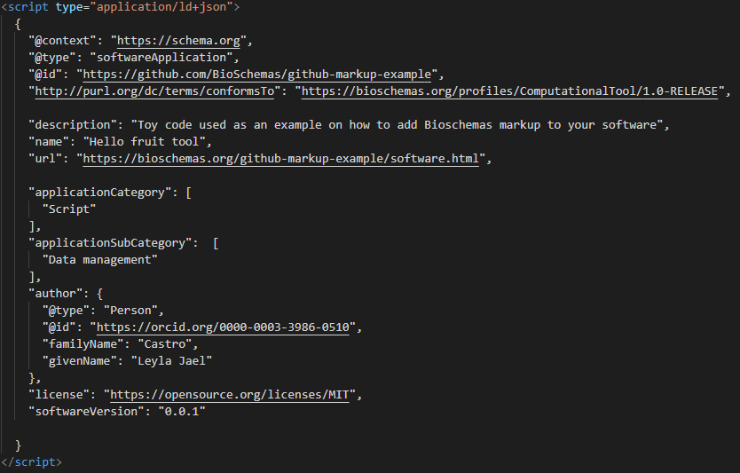

Slide 10
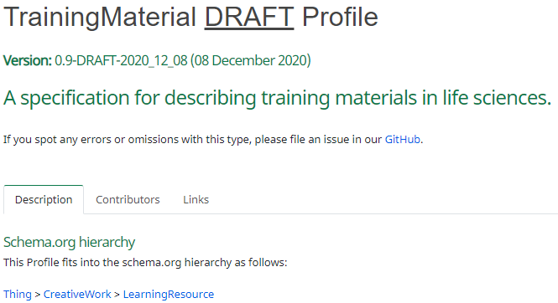
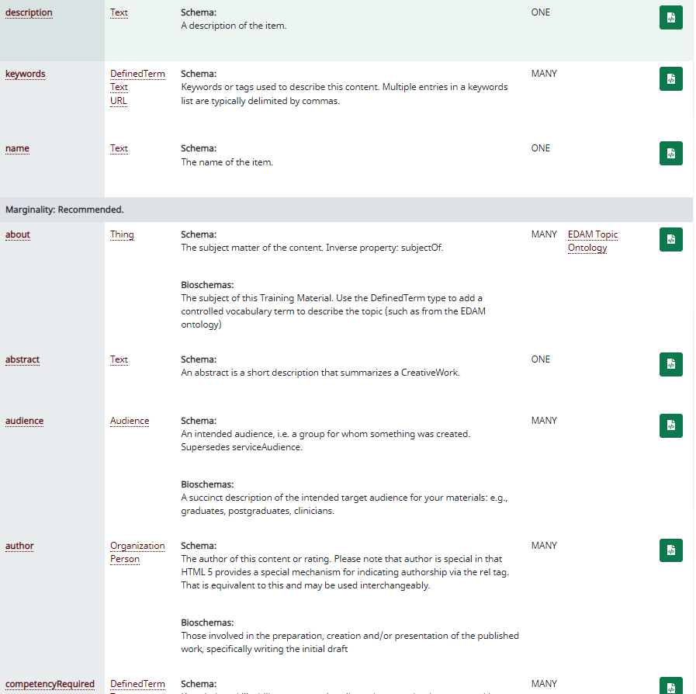
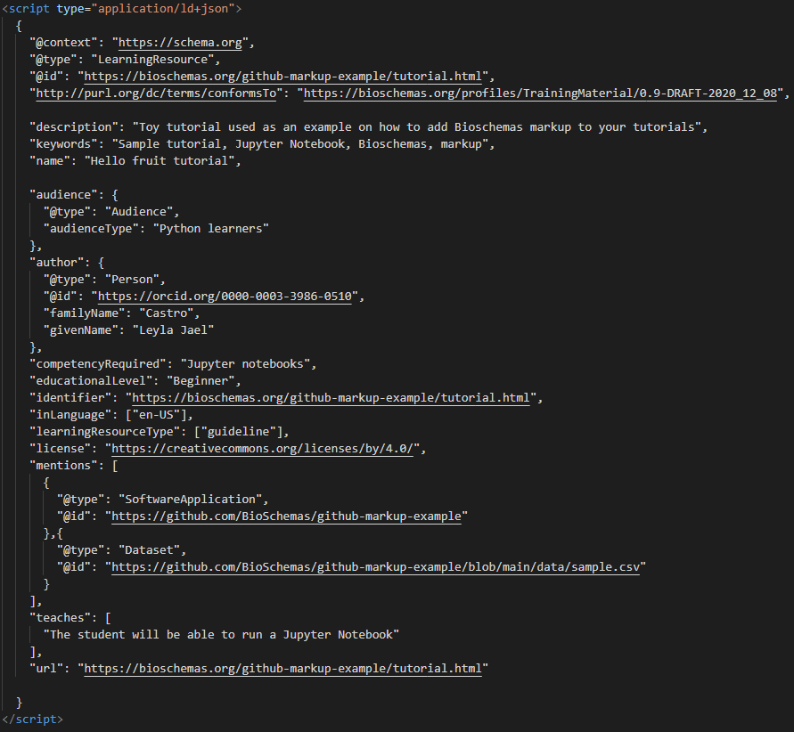

Slide 11
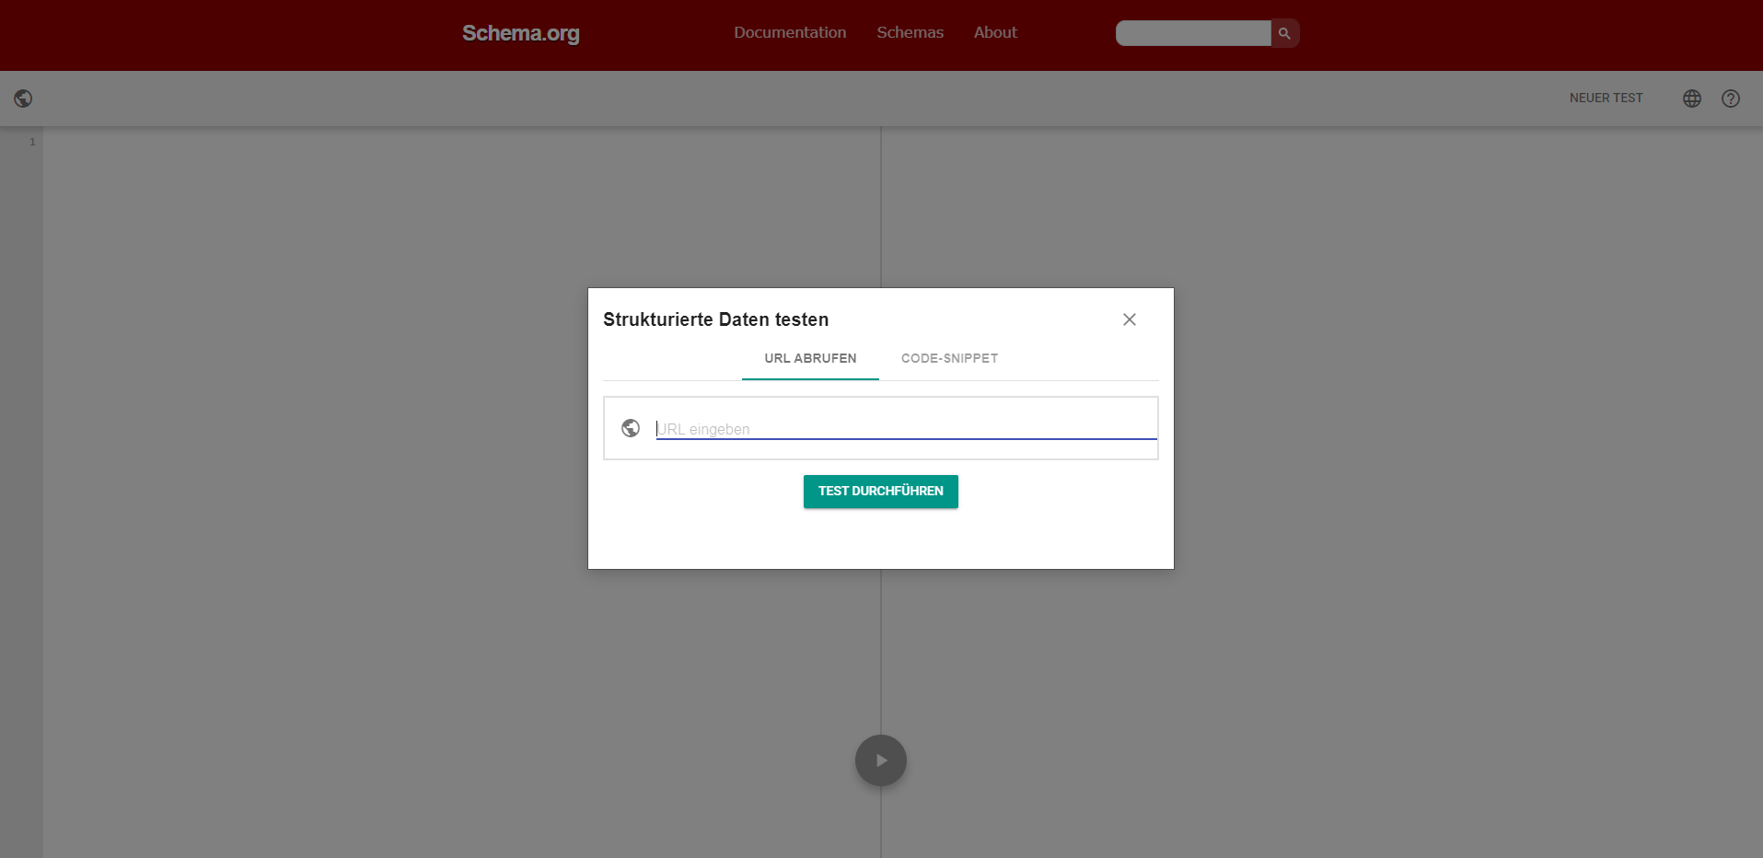
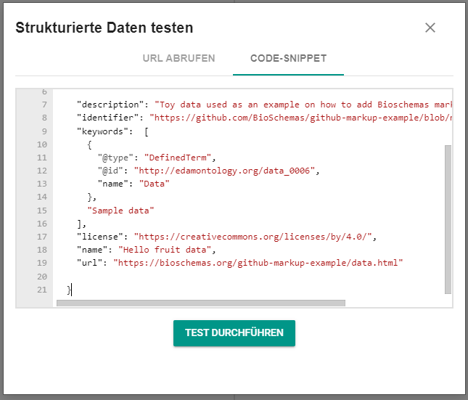
Double check your markup with a validator
https://validator.schema.org/

Slide 12
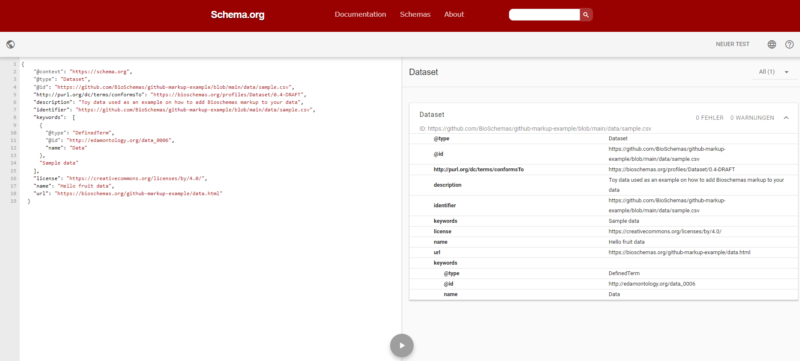
So far so good

Slide 13
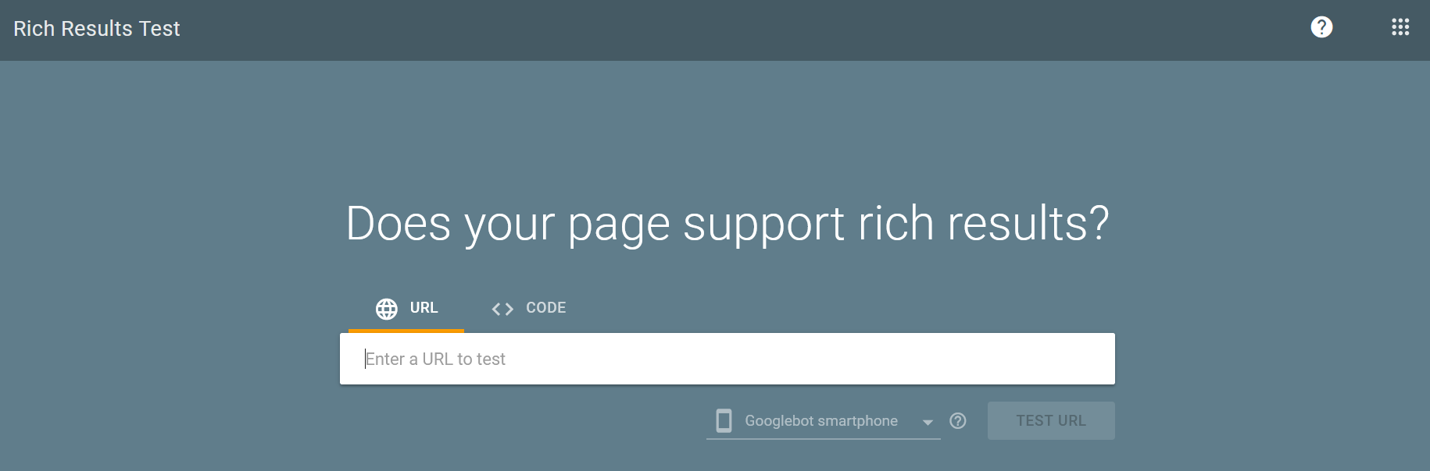
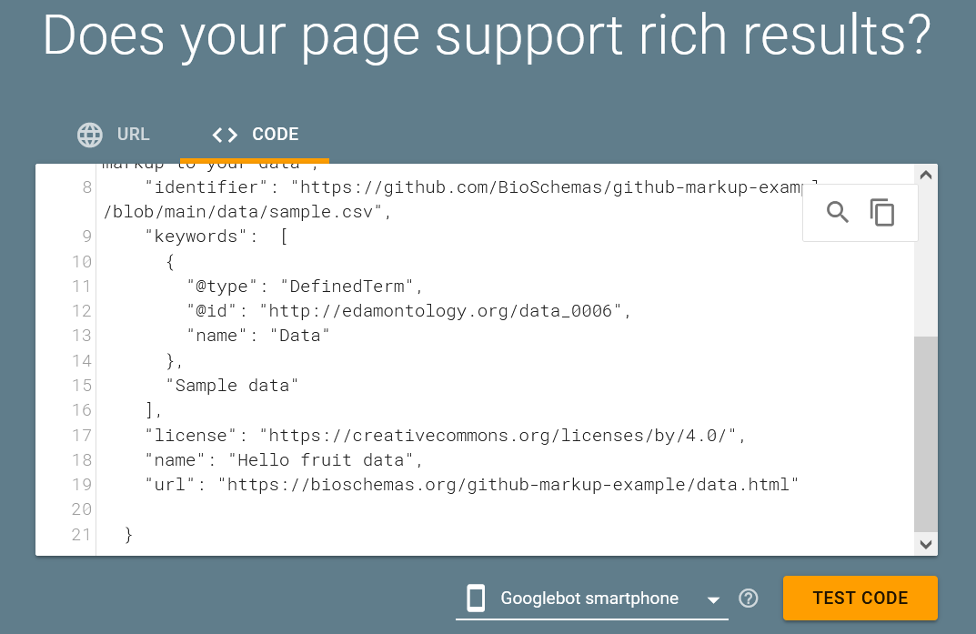
Double check your markup with a validator
https://search.google.com/test/rich-results

Slide 14
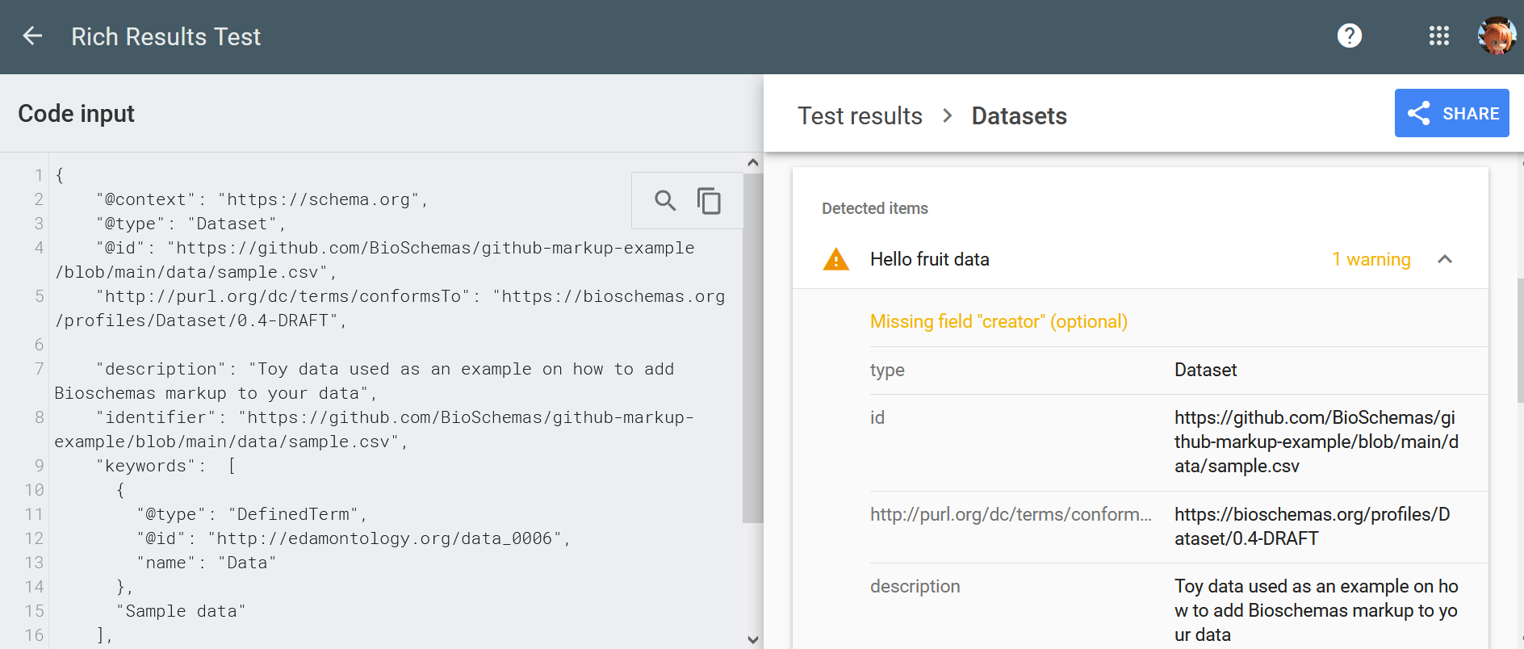
This one is a bit more strict but still we are good

Slide 15
Adding markup and rendering data via layouts

Slide 16
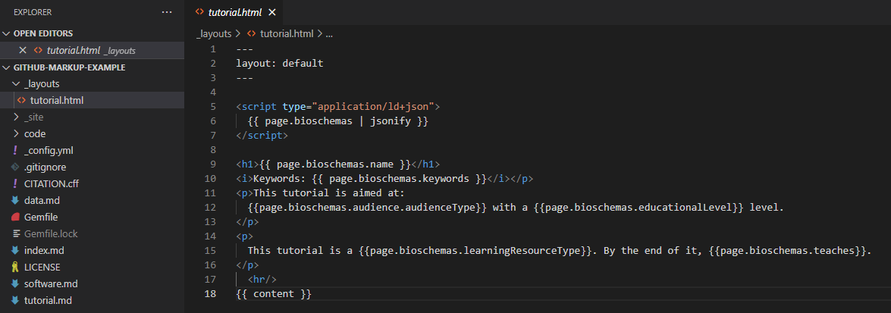
Adding a layout

Slide 17
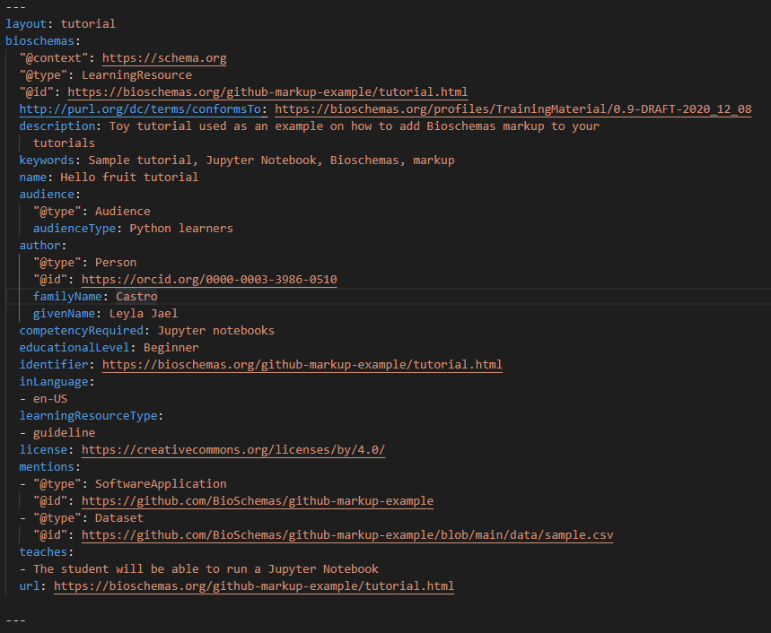
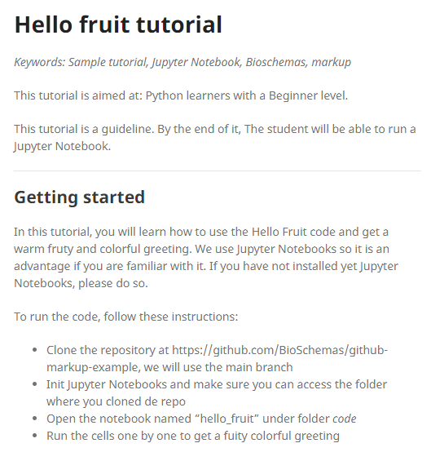
Adding Bioschemas markup

Slide 18
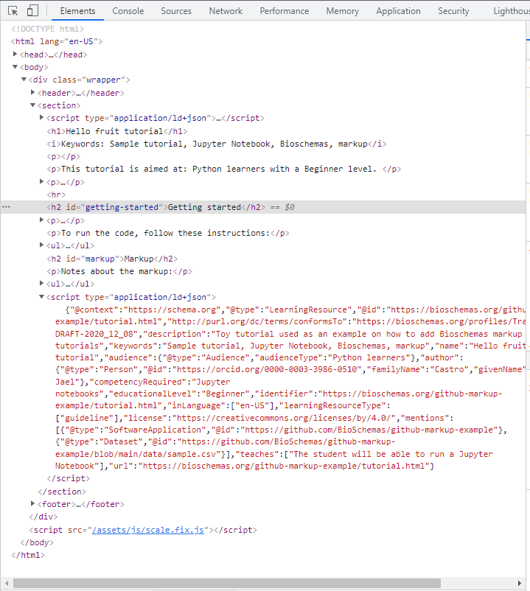
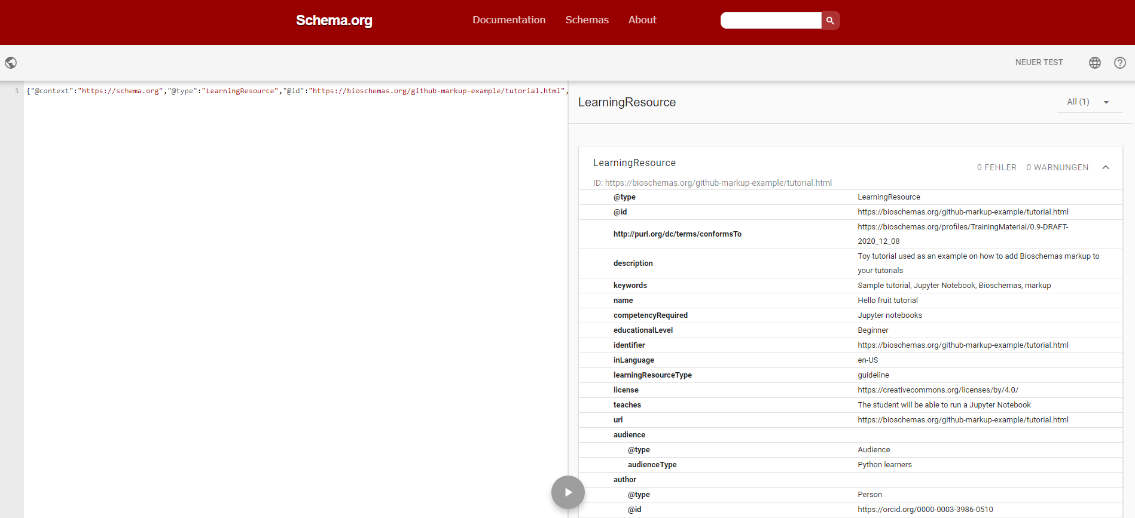
Rendered markup

Slide 19
Make it easier for machines

Slide 20
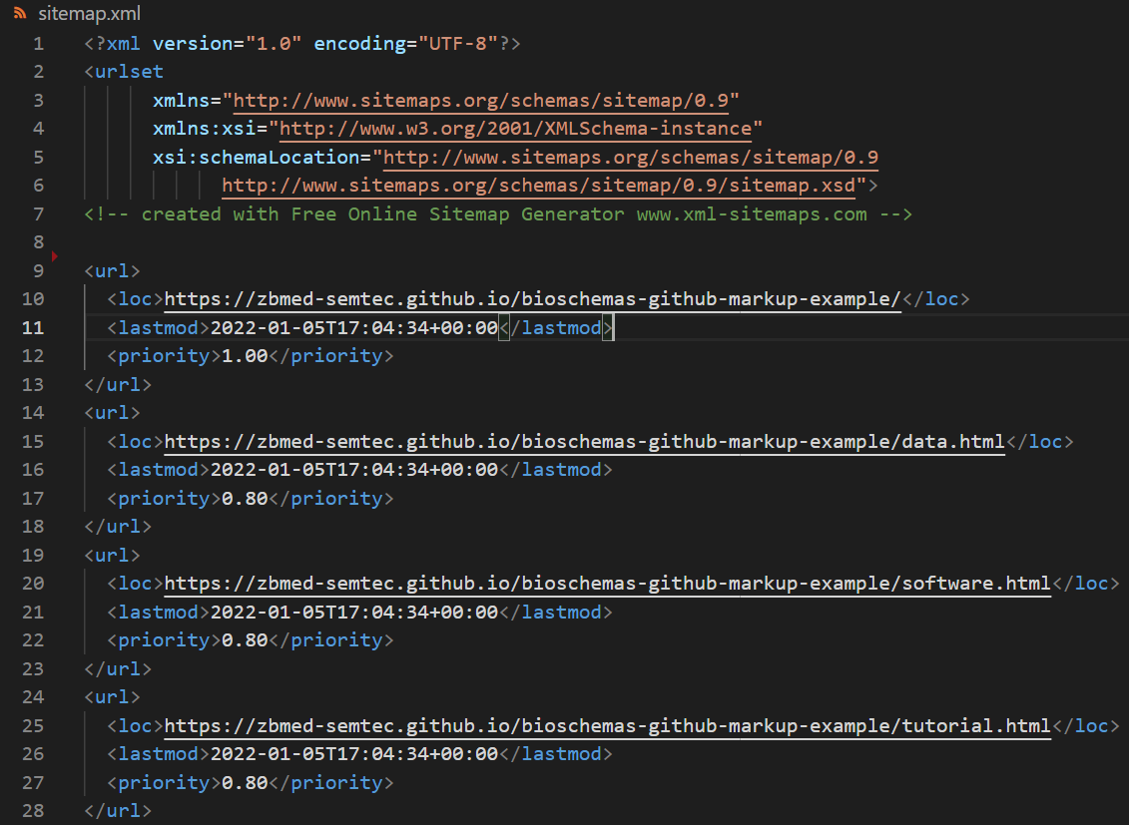
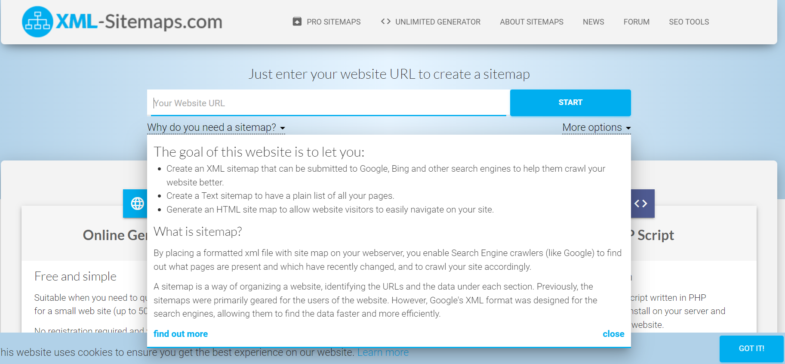
Sitemap.xml and robots.txt
https://www.xml-sitemaps.com/
https://developers.google.com/search/docs/advanced/sitemaps/build-sitemap

Slide 21
Time to add markup to your own pages ☺

Slide 22
Questions?
Website: bioschemas.org
Mailing list: public-bioschemas@w3.org
Slack: http://tiny.cc/bs-slack
Example markup: https://github.com/BioSchemas/specifications/
Live deployments: https://bioschemas.org/liveDeploys/

